Slide 1
Deriving of threshold values in soil and groundwater for non-regulated substances
Formation risques Fedexsol

Slide 2
Overview
1. Context
2. Objectives
3. Overall approach
3.1 Substance properties
3.2 Methodology – general
3.3 Methodology – Conceptual site model
4 Derivation of threshold values based on human exposure
4.1 Methodology
4.2 In soil
4.3 In groundwater
5. Derivation of threshold values based on migration (VSN)
6. Conclusion Arcadis
7. Conclusion DAS

Slide 3
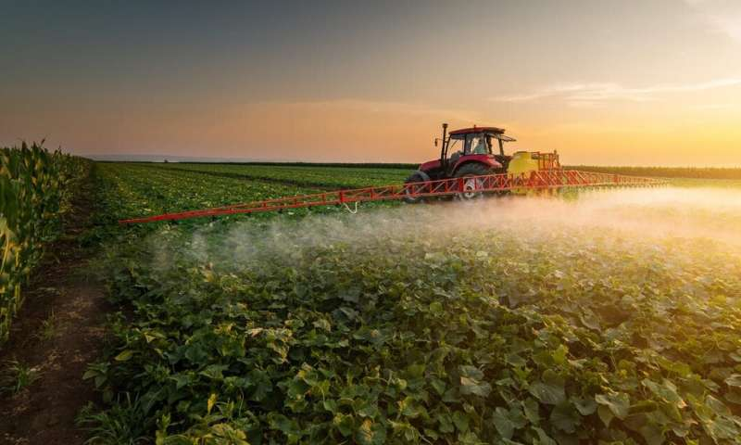
1. Context
Site contaminated with insecticides in soil and groundwater
Some contaminants are non-regulated compounds → no soil remediation standards available
Threshold values* proposed by DAS but :
lower than or equal to the laboratory detection limit
no threshold calculated due to absence of toxicological and/or
physicochemical data
* Threshold values in soil and groundwater are defined as “level of contamination (in mg/kg dry matter or μg/l) above which potential negative effects on human health or the local environment cannot be excluded”
Source : https://phys.org

Slide 4
2. Objectives
Desk study to collect and review existing toxicological and physicochemical data on the compounds where insufficient information was identified by DAS
Use these collected data to calculate site specific threshold values for specific compounds based on Walloon methodology (GRER v2 and v3)
Notes:
GRER: guide de référence pour l'étude de risques

Slide 5
3. Overall approach
Collection of physical-chemical and toxicological data of the non-regulated compounds if not readily available *
Development of high-level Conceptual Site Model (CSM)
Determination of the threshold values:
based on human exposure
based on migration (pure product and leaching to groundwater)
* Material Safety Data Sheets (MSDS), online databases (IRIS, EPA, Texas Risk Reduction Program)

Slide 6
3.1 Substance properties
physical-chemical data
toxicological data
MW
Density
Tolerable daily intake (TDI) or Reference dose (Rf)
S
HLC@25°C
Inhalation & oral uptake
VP
Koc
log Kow
Kp
Dia, Diw
If more than 1 Henry-constant → range to assess sensitivity
For compounds with lacking data → data based on surrogate compound

Slide 7
3.2 Methodology - general
Calculation of :
- VSH: threshold value in soil below which there is no risk expected to human health
- VSN: threshold value in soil below which there is no significant leaching to groundwater
- VSnappe: threshold value in groundwater below which there is no risk expected to human health
Difficult to calculate one explicit threshold value (contrasting literature data) → various threshold values based on different perspectives:
modelling human exposure
prevent presence of pure product (human exposure and migration)
prevent significant leaching to groundwater (migration)
groundwater used as drinking water
Range of threshold values → more robust understanding of anticipated risk
Notes:
Contrasting H-constant referenced for some compounds

Slide 8
3.2 Methodology - general
Overview of the derived threshold values in soil
Overview of the derived threshold values in groundwater
Principle | Purpose
Human exposure (VS_{H}) | The protection of human health from contamination in soil based on the model S-Risk
 | The protection of human health from the presence of pure product
Migration risks (VS_{N}) | The protection of water resource receptors from significant leaching from soils based on VS_{nappe} - use as drinking water
 | The protection of water resource receptors from significant leaching from soils based on VS_{nappe} - no indication of pure product
Principle | Purpose
Human exposure (VS_{nappe}) | Protection of human health – use as drinking water
 | Protection of human health from contamination in groundwater based on the model S-Risk
 | Protection of human health from threshold values in soil (VS_{H})
 | Protection of human health from the presence of pure product
Notes:
S-Risk doesn’t account for pure product concentrations – actually, in case of volatile compounds, when there are indications of pure product, transport through (soil) air via diffusion is no longer applicable, but transport is driven by vapour pressure and S-Risk outcome are no longer reliable

Slide 9
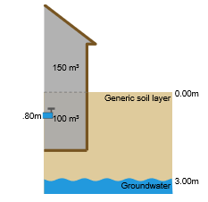
3.3 Methodology – Conceptual site model
Site and soil characteristics :
Industrial site → light industry
Default characteristics and values :
Basement with gaps and holes & drinking water pipes
Building characteristics (volume etc)
Generic soil layer (favours mobility of pure product)
pH, organic content, clay content
groundwater depth of 3 m-bgl
Light industry & default values

Slide 10
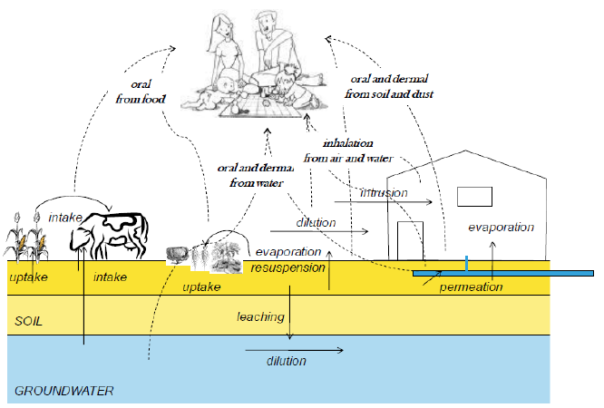
3.3 Methodology – Conceptual site model
Transport routes
light industry
permeation trough drinking water pipe only for (mono)chlorobenzene (no other data available)
Physical-chemical properties of compounds: high solubility and low retardation to soil → leaching to groundwater is most important transport route
Exposure routes : all but
inhalation of bathroom air
dermal contact through bathing/showering
dietary intake vegetables and/or meat
Receptors
adults
Potential / future CSM = current CSM
Représentation schématique des voies de transfert et des voies d’exposition implémentées dans le logiciel S-Risk© (Source : S-Risk – Technical Guidance Document, VITO, 2014)
Notes:
All possible transport routes in light industry are taken into account
Why not inhalation of bathroom air and dermal contact bath/shower? There are showers available I think

Slide 11
4 Derivation of threshold values based on human exposure
4.1 Derivation of threshold values based on human exposure (VS_{H} & VS_{nappe}) with S-Risk – Methodology
Overview of the derived threshold values in soil
Overview of the derived threshold values in groundwater
Principle | Purpose
Human exposure (VS_{H}) | The protection of human health from contamination in soil based on the model S-Risk
 | The protection of human health from the presence of pure product
Migration risks (VS_{N}) | The protection of water resource receptors from significant leaching from soils based on VS_{nappe} - use as drinking water
 | The protection of water resource receptors from significant leaching from soils based on VS_{nappe} - no indication of pure product
Principle | Purpose
Human exposure (VS_{nappe}) | Protection of human health from contamination in groundwater based on the model S-Risk
 | Protection of human health – use as drinking water
 | Protection of human health from threshold values in soil (VS_{H})
 | Protection of human health from the presence of pure product
Notes:
S-Risk doesn’t account for pure product concentrations – actually, in case of volatile compounds, when there are indications of pure product, transport through (soil) air via diffusion is no longer applicable, but transport is driven by vapour pressure and S-Risk outcome are no longer reliable

Slide 12
4 Derivation of threshold values based on human exposure
4.1 Derivation of threshold values based on human exposure (VS_{H} & VS_{nappe}) with S-Risk – Methodology
Exposure dose : Tolerable daily intake (TDI; oral, dermal and inhalation) → Risk Index (RI)
Allowable Concentrations in Air : Tolerable Concentration in Air (TCL) or legal standard → Concentration Index (CI)
Drinking water standards : legal standards → Concentration Index (CI)
Methodology
1. Determine sum of the RI (all transfer media) for the derived soil concentration. If RI > 1 → adjust limit value until RI = 1
2. Determine CI per transfer medium. If CI > 1 → adjust limit value until CI = 1
Notes:
Application 3 of S-Risk calculates soil (or groundwater)concentrations at which the criteria are met (per trasfermedium RI=1, sum of RI = 1, ExCR = 1 and CI = 1 per medium)

Slide 13
4.2 Derivation of threshold values based on human exposure (VS_{H}) in soil – Prevention of pure product
Overview of the derived threshold values in soil
Overview of the derived threshold values in groundwater
Principle | Purpose
Human exposure (VS_{H}) | The protection of human health from contamination in soil based on the model S-Risk
 | The protection of human health from the presence of pure product
Migration risks (VS_{N}) | The protection of water resource receptors from significant leaching from soils based on VS_{nappe} - use as drinking water
 | The protection of water resource receptors from significant leaching from soils based on VS_{nappe} - no indication of pure product
Principle | Purpose
Human exposure (VS_{nappe}) | Protection of human health from contamination in groundwater based on the model S-Risk
 | Protection of human health – use as drinking water
 | Protection of human health from threshold values in soil (VS_{H})
 | Protection of human health from the presence of pure product
Notes:
S-Risk doesn’t account for pure product concentrations – actually, in case of volatile compounds, when there are indications of pure product, transport through (soil) air via diffusion is no longer applicable, but transport is driven by vapour pressure and S-Risk outcome are no longer reliable

Slide 14
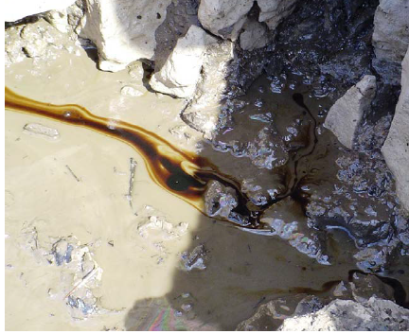
4.2 Derivation of threshold values based on human exposure (VS_{H}) in soil – Prevention of pure product
Pure product = potential risk to human health
S (mg/l): maximum solubility (substance specific)
Kd (l/kg): soil water partitioning coefficient (substance specific)
Koc (l/kg): organic carbon – water partition coefficient (substance specific)
foc (-): fraction organic carbon, foc = OM x 0.0058
OM (%): organic matter (default value = 1.6 %)
Source: Advances in remediation, a new way of thinking. Arcadis, 2016
Contaminant concentration in soil < 10 % max solubility → pure product not expected

Slide 15
4.2 Derivation of threshold values based on human exposure (VS_{H}) in soil – Comparison
2 values for allowable concentration in soil :
based on S-Risk model
based on pure product prevention
Most stringent value = lower limit for human toxicological threshold value
Highest value = upper limit
Principle | Purpose
Human exposure (VS_{H}) | The protection of human health from contamination in soil based on the model S-Risk
 | The protection of human health from the presence of pure product
Range of threshold values

Slide 16
4.2 Derivation of threshold values based on human exposure (VS_{H}) in soil
Parameter |  | VS_{H} (mg/kg) Calculated with S-Risk | Theoretically calculated value corresponding to 10% solubility * (mg/kg)
Acetochlor |  | 122 10³ | 62
Diallate |  | 3 | 8
Dicamba |  | 248 10³ | 224
Diquat |  | 13 10³ | 6 10⁶
Glyphosate |  | 1 10⁶ | 14 10³
(mono)chlorobenzene |  | 25 | 0.9
Napropamide |  | 597 10³ | 218
Paraquat |  | 27 10³ | 5 10⁶
Propionic acid |  | 1 10⁶ | 1250
Thiocarbamates | Butylate | 303 10³ | 16
 | Cycloate | 338 10³ | 19
 | S-ethyl dipropylthiocarbamate (EPTC) | 153 10³ | 57
 | Esprocarb | 30 10³ | 20
 | Ethiolate | 3 | 164
 | Molinate | 8969 | 164
 | Orbencarb | 30 10³ | 8
 | Pebulate | 296 10³ | 28
 | Prosulfocarb | 30 10³ | 233
 | Vernolate | 4716 | 25
Note : different H-constants for some compounds did not effect the calculated human
toxicological threshold value in soil
(1) Concentration in the soil corresponding to 10% maximum solubility in the groundwater (converted via the Kd)
Until 3 orders of magnitude difference S-Risk & Solubility

Slide 17
4.3 Derivation of threshold values based on human exposure (VS_{nappe}) – Calculation in groundwater
Overview of the derived threshold values in soil
Overview of the derived threshold values in groundwater
Principle | Purpose
Human exposure (VS_{H}) | The protection of human health from contamination in soil based on the model S-Risk
 | The protection of human health from the presence of pure product
Migration risks (VS_{N}) | The protection of water resource receptors from significant leaching from soils based on VS_{nappe} - use as drinking water
 | The protection of water resource receptors from significant leaching from soils based on VS_{nappe} - no indication of pure product
Principle | Purpose
Human exposure (VS_{nappe}) | Protection of human health from contamination in groundwater based on the model S-Risk
 | Protection of human health – use as drinking water
 | Protection of human health from threshold values in soil (VS_{H})
 | Protection of human health from the presence of pure product
Notes:
S-Risk doesn’t account for pure product concentrations – actually, in case of volatile compounds, when there are indications of pure product, transport through (soil) air via diffusion is no longer applicable, but transport is driven by vapour pressure and S-Risk outcome are no longer reliable

Slide 18
4.3 Derivation of threshold values based on human exposure (VS_{nappe}) – Calculation in groundwater
Threshold value via model calculations : S-Risk
Threshold value for use as drinking water
Non-carcinogenic substances Carcinogenic substances
RfD0: Oral Reference dose (mg/kg bw.d) SF: slope factor ((mg/kg bw.d)-1)
W: body weight (60 kg)
Q: drinking water consumption per person (2 l/d)
RF: reduction factor : contribution of the general exposure of the
population to the substance, (default value = 0,2)

Slide 19
4.3 Derivation of threshold values based on human exposure (VS_{nappe}) – Calculation in groundwater
Threshold value based on VSH and no pure product
Fv (-) : redistribution factor in the unsaturated zone (default value = 1)
Ksw (kg/l) :soil water partitioning factor
FD : dilution factor (default value = 30)
Range of threshold values

Slide 20
4.3 Derivation of threshold values based on human exposure (VS_{nappe}) in groundwater – Comparison
Principle | Purpose
Human exposure (VS_{nappe}) | Protection of human health from contamination in groundwater based on the model S-Risk
 | Protection of human health – use as drinking water
 | Protection of human health from threshold values in soil (VS_{H})
 | Protection of human health from the presence of pure product
4 values for allowable concentration in groundwater :
based on S-Risk model
for use as drinking water
based on VSH
based on no pure product
Calculated threshold values based on the use of drinking water = lower limit for human toxicological threshold value
Most stringent of VSnappe,H with S-Risk and VSnappe,10% S = upper limit
Range of threshold values

Slide 21
4.3 Derivation of threshold values based on human exposure (VS_{nappe}) in groundwater – Comparison
Parameter |  | VSnappe (µg/l) | VSnappe, _{H} (µg/l) with S-Risk | VSnappe, VSH (µg/l) with S-Risk | VSnappe, 10%S (µg/l)
Acetochlor |  | 120 | Max. solubility | 2 10⁶ | 923
Diallate |  | 5* | 600 | 22 | 60
Dicamba |  | 180 | Max. solubility | 23 10⁶ | 21 10³
Diquat |  | 13.2 | Max. solubility | 6751 | 3 10⁶
Glyphosate |  | 600 | Max. solubility | 5 10⁶ | 63 10³
(mono)chlorobenzene |  | 120 | 13 10³ | 4474 | 166
Napropamide |  | 600 | Max. solubility | 883 10³ | 322
Paraquat |  | 27 | Max. solubility | 14 10³ | 3 10⁶
Propionic acid |  | 3 10³ | Max. solubility | 206 10⁶ | 257 10³
Thiocarbamates | Butylate | 300 | Max. solubility | 164 10³ | 9
 | Cycloate | 330 | Max. solubility | 5 10⁶ | 308
 | S-ethyl dipropylthiocarbamate (EPTC) | 150 | Max. solubility | 4 10⁶ | 1470
 | Esprocarb | 30 | Max. solubility | 33 10³ | 22
 | Ethiolate | 5* | 2700 | 70 | 3848
 | Molinate | 12 | Max. solubility | 211 10³ | 3848
 | Orbencarb | 30 | Max. solubility | 217 10³ | 60
 | Pebulate | 300 | Max. solubility | 4 10⁶ | 414
 | Prosulfocarb | 30 | Max. solubility | 7490 | 59
 | Vernolate | 6 | Max. solubility | 211 10³ | 373
Note : different H-constants for some compounds did not effect the calculated human
toxicological threshold value in groundwater
* Threshold value calculated according to the formula for carcinogenic substances
Until 3 orders of magnitude difference S-Risk & Solubility

Slide 22
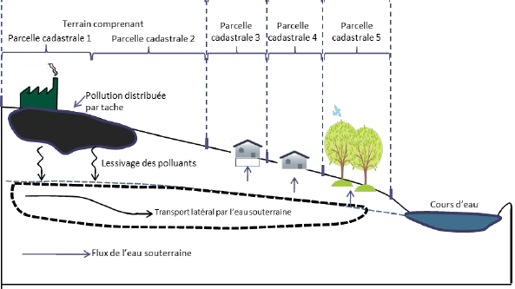
5. Derivation of threshold values based on migration (VS_{N})
Potential leaching of contaminants from soil to groundwater → risk to water resource receptors
Principle | Purpose
Migration risks (VS_{N}) | The protection of water resource receptors from significant leaching from soils based on VS_{nappe} - use as drinking water
 | The protection of water resource receptors from significant leaching from soils based on VS_{nappe} - no indication of pure product
Source: Code de Bonnes pratiques pour l’étude de risques. Bruxelles Environnement, v 31/05/2019

Slide 23
5.1 Derivation of threshold values based on migration (VS_{N}) - methodology
VSnappe (μg/l): threshold value in groundwater (substance specific)
FD: dilution factor (default value = 30)
Fv (-): redistribution factor in the unsaturated zone (default value = 1)
Ksw (kg/l), the soil water partitioning factor
Notes:
VSnappe = concentration for use as drinking water
Also instead of Vsnappe, 10% solubility used for prevention of pure product

Slide 24
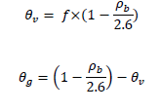
5.1 Derivation of threshold values based on migration (VS_{N}) - methodology
fads: adsorption factor (default value for industry = 0.75)
Kd (l/kg): soil water partitioning coefficient (substance specific)
ρb: soil density (default value = 1.45 kg/dm³)
H’: dimensionless Henry constant (substance specific)
θv: water filled porosity
θg: air filled porosity
f: fraction of the pores filled with water (default value = 0.5)

Slide 25
5.2 Derivation of threshold values based on migration (VS_{N}) – Comparison
2 values for allowable concentration in soil :
Based on conservative groundwater concentration (drinking water quality)
Based on a groundwater concentration that equates to 10% solubility (prevention of pure product)
Most stringent of VSN and VSN,10% S = lower limit
Hihest value = upper limit
Principle | Purpose
Migration risks (VS_{N}) | The protection of water resource receptors from significant leaching from soils based on VS_{nappe} - use as drinking water
 | The protection of water resource receptors from significant leaching from soils based on VS_{nappe} - no indication of pure product
Range of threshold values

Slide 26
5.2 Derivation of threshold values based on migration (VS_{N}) – Comparison
Parameter |  | VS_{N} (mg/kg) | VS_{N, 10%S} (mg/kg)
Acetochlor |  | 8 | 1491
Diallate |  | 0.7 | 195
Dicamba |  | 2 | 8836
Diquat |  | 26 | 137 10⁶
Glyphosate |  | 128 | 312 10³
(mono)chlorobenzene |  | 0.7 | 279
Napropamide |  | 406 | 4938
Paraquat |  | 52 | 486 10⁶
Propionic acid |  | 14.5 | 486 10³
Thiocarbamates | Butylate | 25 | 383
 | Cycloate | 20 | 460
 | S-ethyl dipropylthiocarbamate (EPTC) | 6 | 1457
 | Esprocarb | 27 | 448
 | Ethiolate | 0.2 | 4128
 | Molinate | 0.5 | 4128
 | Orbencarb | 4 | 195
 | Pebulate | 20 | 671
 | Prosulfocarb | 119 | 5250
 | Vernolate | 0.4 | 603
Note : different H-constants for some compounds did not effect the calculated threshold leaching value, except for butylate
Until 6 orders of magnitude difference

Slide 27
6 Conclusion Arcadis
Proposed threshold values for soil based on both human health risks and significant leaching to groundwater
Proposed value by Arcadis
If value DAS in range value Arcadis → value DAS proposed
If value DAS higher than value Arcadis → value DAS proposed
If value DAS lower than value Arcadis → lower limit Arcadis proposed
Compounds with detection limits (DL) higher then proposed threshold values => 5 x DL
Proposed threshold values for groundwater based on both human health risks, migration risks and use as drinking water
Threshold values DAS much lower than threshold values Arcadis → new propositions

Slide 28
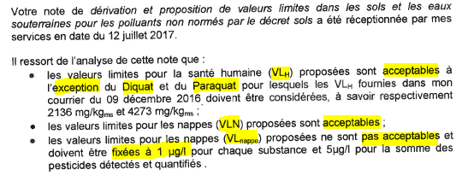
7 Conclusion DAS
Did DAS agree with the proposed threshold values? …
DAS partially agreed on threshold values proposed by Arcadis
Notes:
The proposed threshold values by Arcadis in soil based on human exposure which were higher than the DAS-values were not accepted, but the higher threshold values to prevent leaching we proposed in soil were accepted.
We certainly did not do unnecessary work by calculating groundwater threshold values => these will still be considered when remediation needs to be done

